Slide 1
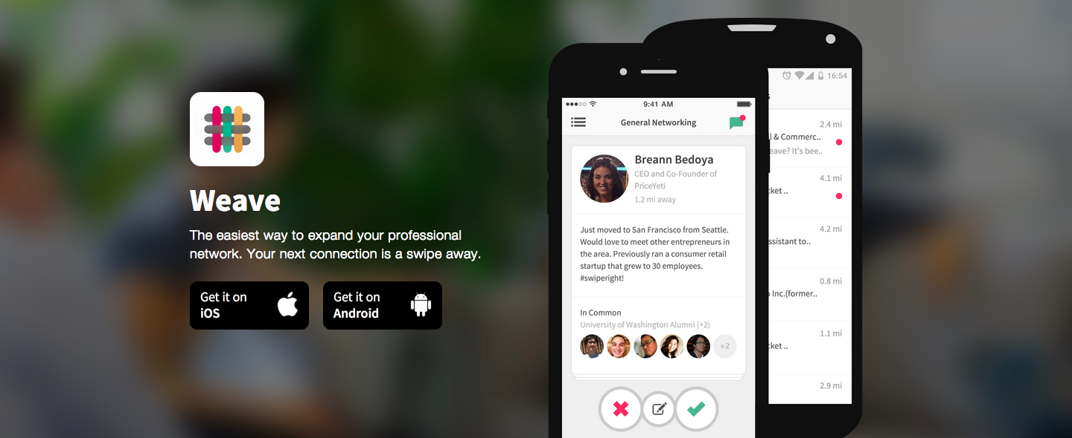
FastMatch:
Pairing Algorithm for people to extend professional network
Jiong Zhang
Insight Data Science

Slide 2

The problem
Weave Concierge
matches users for professional meetings
Notes:
One slide that clearly states and motivates the problem, as well as what the company does.
1, NLP algorithm for processing comments to get another set of features of the users (valuable data themselves)
2, Core algorithm utilizing RF or LR (can be used as a recommendation engine)
3, have the match list to maximize number of good meetings

Slide 3
The problem
Weave Concierge
matches users for professional meetings
Notes:
One slide that clearly states and motivates the problem, as well as what the company does.
1, NLP algorithm for processing comments to get another set of features of the users (valuable data themselves)
2, Core algorithm utilizing RF or LR (can be used as a recommendation engine)
3, have the match list to maximize number of good meetings

Slide 4
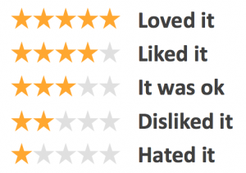
The problem
Weave Concierge
matches users for professional meetings
Notes:
One slide that clearly states and motivates the problem, as well as what the company does.
1, NLP algorithm for processing comments to get another set of features of the users (valuable data themselves)
2, Core algorithm utilizing RF or LR (can be used as a recommendation engine)
3, have the match list to maximize number of good meetings

Slide 5
Goal: Develop a Pairing Algorithm to Maximize a Good Meeting
The problem
Weave Concierge
matches users for professional meetings
Notes:
One slide that clearly states and motivates the problem, as well as what the company does.
1, NLP algorithm for processing comments to get another set of features of the users (valuable data themselves)
2, Core algorithm utilizing RF or LR (can be used as a recommendation engine)
3, have the match list to maximize number of good meetings

Slide 6

The deliverable for Weave
Manually matching
good meetings: 85%
Automated matching
good meetings: 96%
good meetings
Notes:
Based on historical data

Slide 7



The data workflow
Meeting
feedbacks
(ratings=
1, 2, 3, 4, 5 )
labels
Available
data:
title,
education,
gender,
looking_for,
meeting history
Weave
database
Feature
calculation
Meeting
features
(Combined
user features)
features
LinkedIn
profile
Notes:
english

Slide 8
The model training and evaluation
10-fold cross-validation
on training set
Feature selection
Model parameters optimization
Model selection
(Random forests;
logistic regression;
k neighbors)
Model evaluation
on testing set
Best model: Random forests
67% predictions obtain actual rating
95% predictions obtain rating +/- 1
RMSD: 0.75
Notes:
Training data set for each user is too small
Divide user categories
Consensus score for each user (show implicit feature)
Feedback + rating for Completing the profile (data to sell)
Rate meeting & rate user?

Slide 9
The insights for Weave
Weave is implementing this algorithm
Automated matching
maximizes good meetings
Recommendation engine
matches people from different cities
during their visits
Notes:
Mention twice for 2 weeks

Slide 10

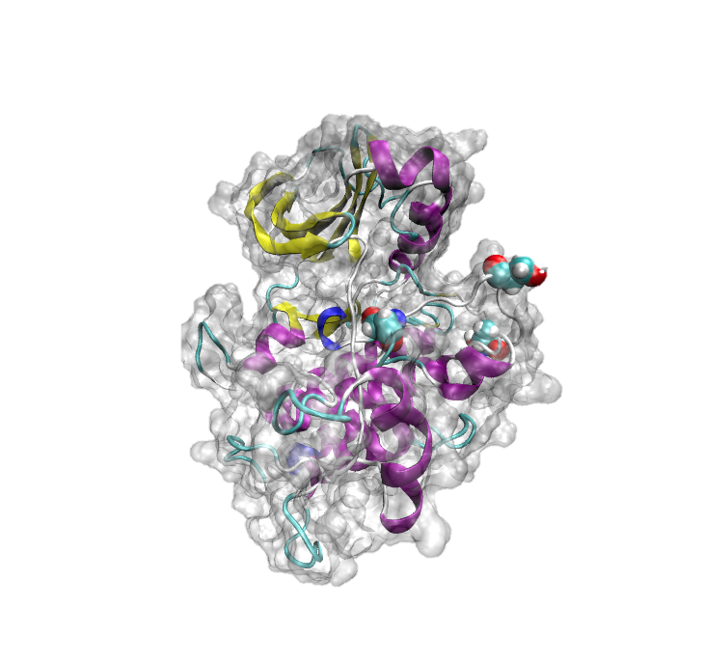

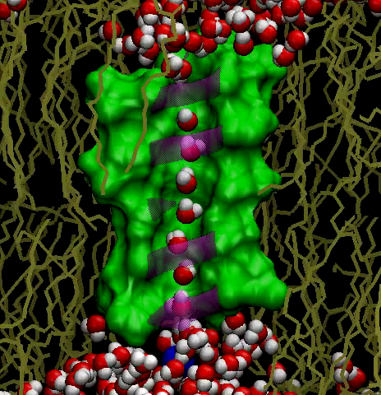

Jiong Zhang
Ph.D. in Theoretical and Computational Biological Physics
Dissertation: Theoretical and computational studies on
bio-molecular systems: structures and dynamics

